Slide 1




22.06 Release
@RAPIDSai
https://github.com/rapidsai
https://rapids-goai.slack.com/join
https://rapids.ai
Notes:
https://rapids.ai/ https://github.com/rapidsai
https://docs.rapids.ai/overview

Slide 2
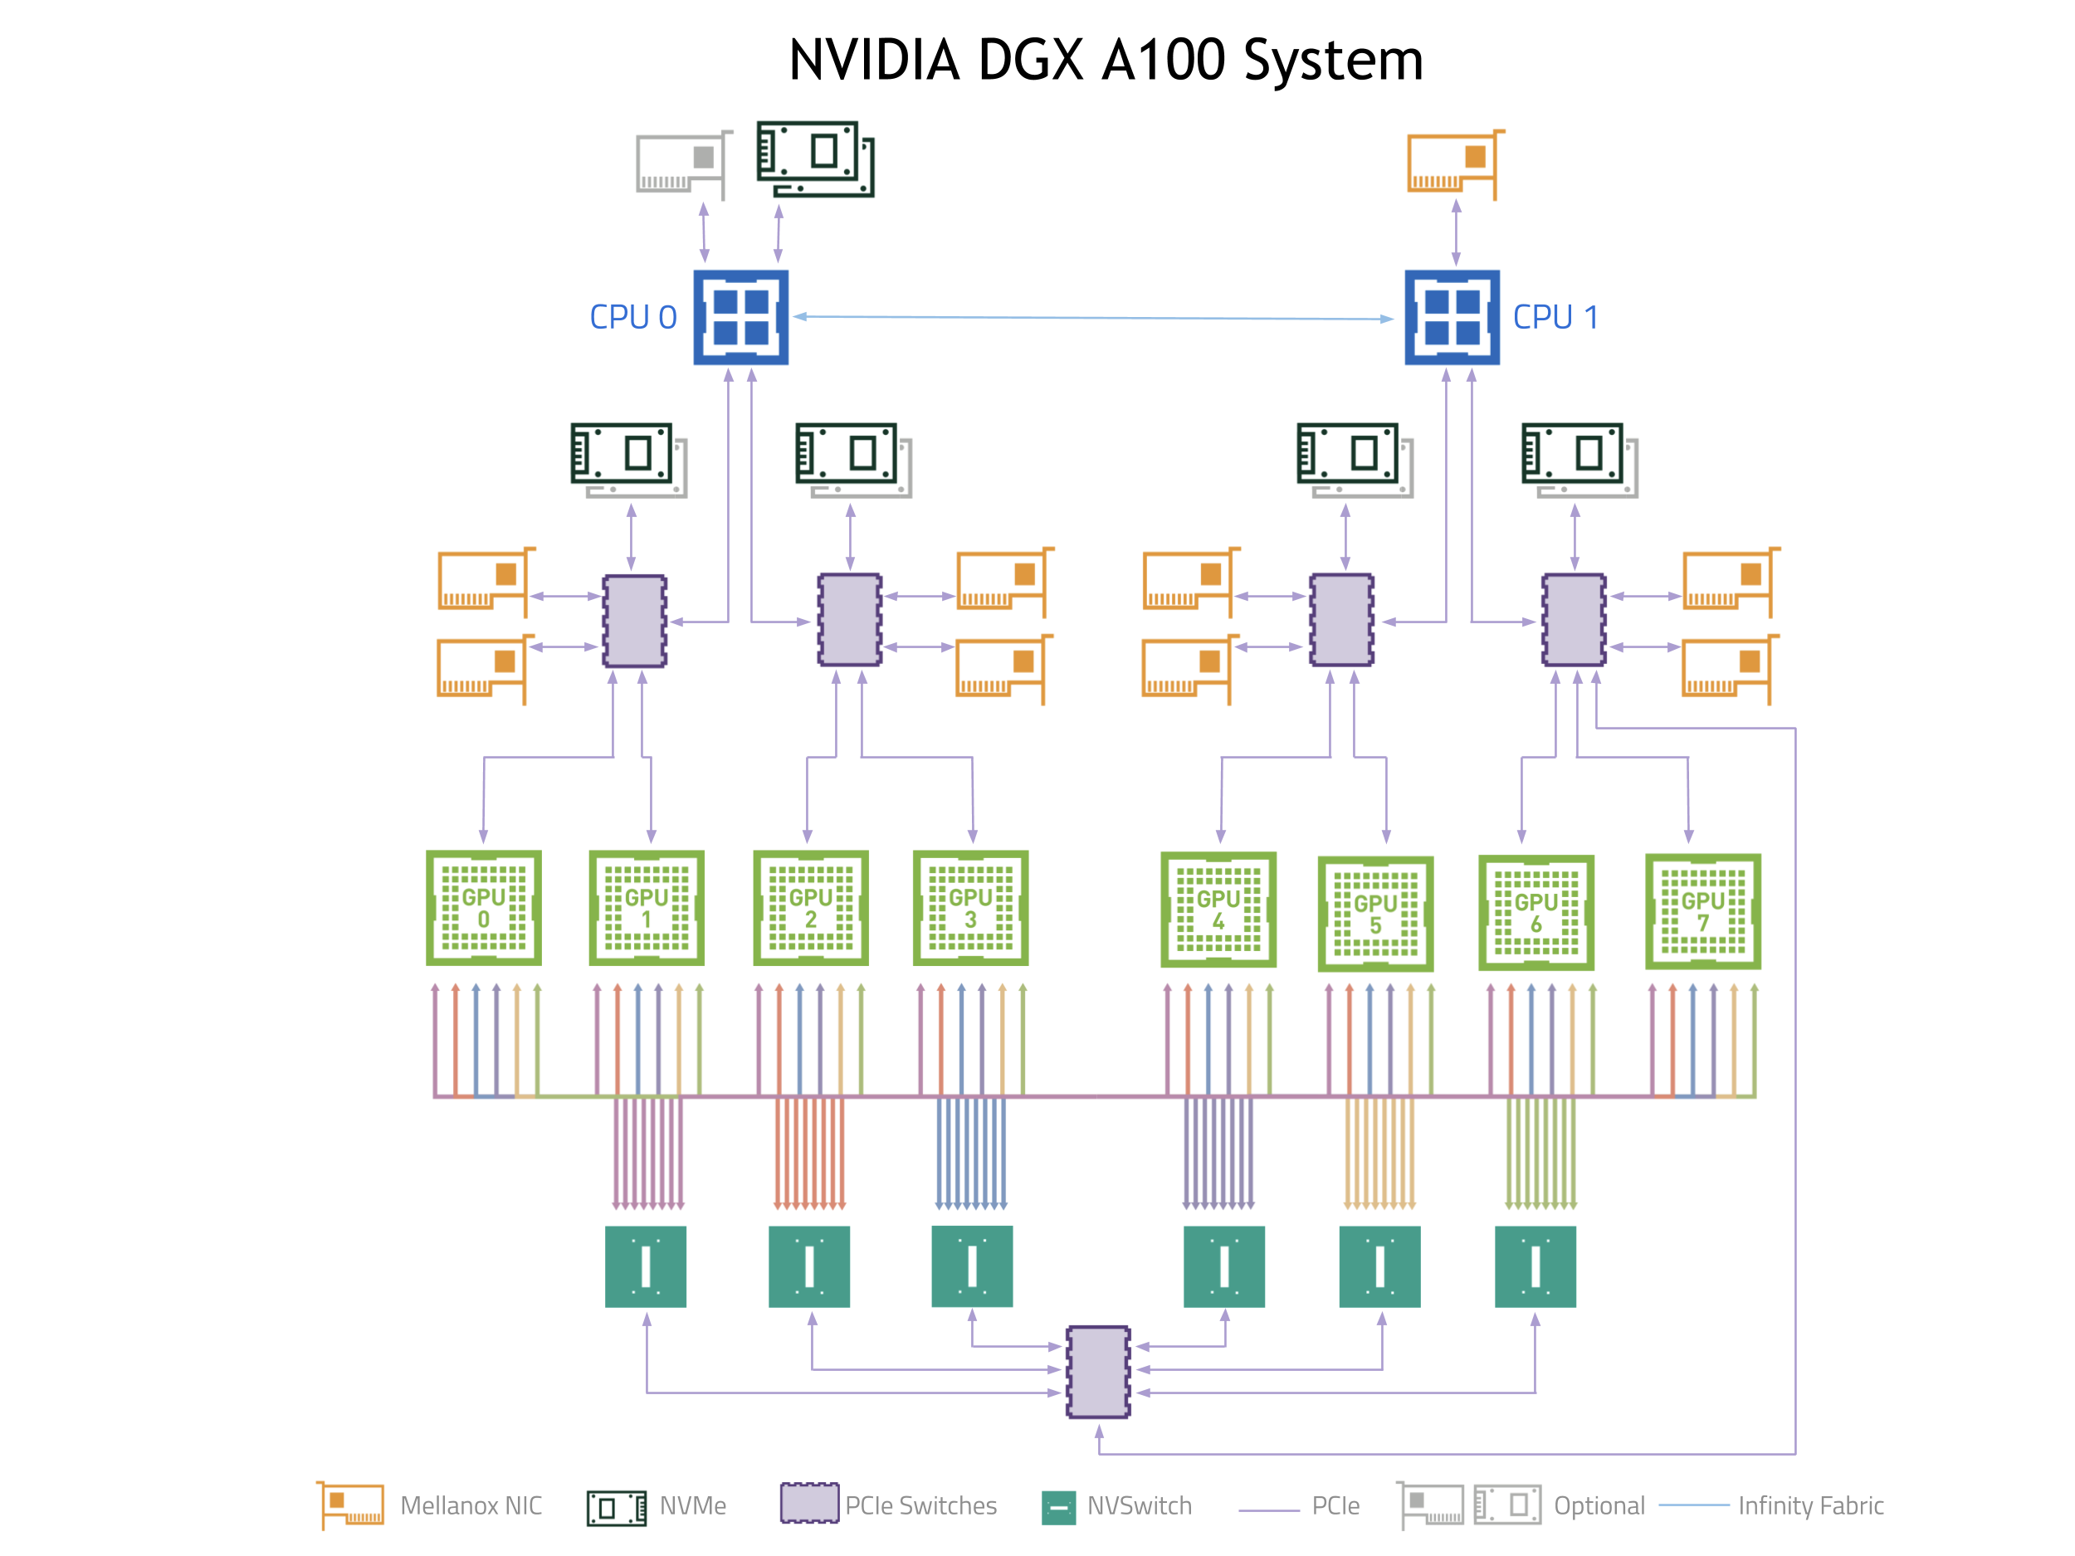
Why GPUs for Data Science?
Numerous hardware advantages
Thousands of cores with up to ~20 TeraFlops of general purpose compute performance
Up to 1.5 TB/s of memory bandwidth
Hardware interconnects for up to 600 GB/s bidirectional GPU <--> GPU bandwidth
Can scale up to 16x GPUs in a single node
Almost never run out of compute relative to memory bandwidth!

Slide 3
What is RAPIDS?
End-to-End GPU Accelerated Data Science
Data Preparation/ETL
Analytics/ML/Graph
Visualization
cuDF
GPU-accelerated ETL functions
Tracks Pandas and other common PyData APIs
Dask + UCX integration for scaling
RAPIDS ML
GPU-native cuML library, plus XGBoost, FIL, HPO, and more
cuGraph
GPU graph analytics, including TSP, PageRank, and more
cuxfilter
GPU-accelerated cross-filtering
pyViz integration
Plotly Dash, Bokeh, Datashader, HoloViews, hvPlot
Domain-Specific Libraries
CLX + Morpheus Cyber log processing + anomaly detection | cuSignal Signals processing | cuSpatial Spatial analytics
cuStreamz Streaming analytics | cuCIM Computer vision & image processing primitives | node-RAPIDS Bindings for node.js
...and more!

Slide 4
Major updates from the RAPIDS 22.06 release
The release of a new RAPIDS Graph-as-a-Service library GaaS uses cuGraph, cuDF, and other libraries on the server to execute graph data prep and analysis on server-side GPUs. Multiple clients can connect to the server allowing different users and processes the ability to access large graph data that may not otherwise be possible
The addition of Multi-Node Multi-GPU (MNMG) algorithms across many libraries, including cuML and cuGraph When working with massive amounts of data, it’s not uncommon to run out of room on a single GPU. We continue to expand support for Multi-Node Multi-GPU (MNMG) workloads across RAPIDS libraries
Support for interactive debugging and profiling of memory usage with RMM Memory allocations in RAPIDS are performed by the RAPIDS Memory Manager (RMM). In the 22.06 release of RMM, users can now trigger a callback function when RAPIDS libraries allocate or free memory for interactive debugging, profiling, and a wide range of other use cases

Slide 5
Overview of Changes: RAPIDS 22.06 Release
cuDF Addition of df.eval() for faster and more memory efficient calculations, df.applymap() for element-wise functions
cuML Initial support for multi-node Logistic Regression, based on Dask-GLM, and Dask’s CuPy array support
cuGraph Property Graph available on MNMG architectures; eigenvector centrality algorithm, and Triangle counting algorithm on data located across multiple GPUs
Dask-CUDA Users can now trigger a callback function when RAPIDS libraries allocate or free memory for interactive debugging, profiling, and a wide range of other use cases

Slide 6
cuDF Updates: Deep Dive
Release 22.06
Features added in 22.06
Decompression by “Zstandard” released for Parquet and ORC (experimental)
Merging/Joining is 10-30% faster, due to performance optimization
Documentation updates to user guide, new contributors, library design, C++ doxygen
Upgrade cudf to support pandas 1.4.x versions
Add a section to the docs that compares cuDF with Pandas
Add cudf.DataFrame.applymap
Implement DataFrame.eval using libcudf ASTs
Planned Upcoming Features
Support

Slide 7
cuML Updates: Deep Dive
Release 22.06
Features added in 22.06
First version of Multi-Node Multi-GPU Logistic Regression
LabelEncoder functionality for CuPy and NumPy arrays
Random Ball Cover support for 3D data in Nearest Neighbors
Some other minor tidbits: sample_weight support for Ridge Regression, simplicial_set functions in UMAP
Double precision support in FIL
Planned upcoming features

Slide 8
cuGraph Updates: Deep Dive
Release 22.06
Features added in 22.06
Released the initial version of Graph-as-a-Service
Initial version of a Multi-GPU Property Graph
Initial release of Python wrappers around cugraph-ops aggregators (pylibcugraphops)
New Degree Centrality algorithm
New Multi-GPU Eigenvector Centrality algorithm
New Multi-GPU Triangle Counting algorithm
Planned Upcoming Features
Data Masking
Integration with DGL

Slide 9




Join the Conversation
GOOGLE GROUPS
DOCKER HUB
SLACK CHANNEL
STACK OVERFLOW
https://groups.google.com/forum/#!forum/rapidsai
https://hub.docker.com/r/rapidsai/rapidsai
https://rapids-goai.slack.com/join
https://stackoverflow.com/tags/rapids

Slide 10
THANK YOU
@RAPIDSai
Notes:
https://rapids.ai/ https://github.com/rapidsai
https://docs.rapids.ai/overview

